Slide 1
Lesson 2: Z-Wave Fundamentals
Notes:
Need more info on:
Beam
Wake up CMD class

Slide 2

Z-wave protocol purpose
Provides resilient network requiring little to no maintenance
Allows for a wide range of battery powered nodes
Provides backwards compatibility to any Z-wave device while offering newest features to the node supporting them
UL1023 certified for Household Burglar-Alarm
Notes:
The routing protocol allows for stable frame delivery

Slide 3
Z-Wave PHY/MAC
Public PHY/MAC specification ITU G.9959
https://www.itu.int/rec/T-REC-G.9959-201501-I/en
Z-Wave Frequency Allocation ZAD12837-10
https://zwavealliance.org/wp-content/uploads/2018/03/ZAD12837-10.pdf
Sub GHz, license free ISM bands, region/Country specific
Data rate \ region frequency & channel(s) | US / Canada / South America | EU / UAE / China / India | AU / NZ / Brazil | Japan / Taiwan / Korea / Singapore
9.6kbps FSK Modulation | 908 MHz Ch 1 | 868 MHz Ch 1 | 921 MHz Ch 1 | NA
40kpbs FSK Modulation | 908 MHz Ch 1 | 868 MHz Ch 1 | 921 MHz Ch 1 | NA
100kpbs GFSK Modulation | 916 MHZ Ch 2 | 869 MHz Ch 2 | 919 MHz Ch 2 | 919-926 MHz Ch 1 - 3
Notes:
Z-wave is based on the UT
Benefits of Sub G: Longe range at lower frequency
Downside: different frequency allocation for different regions.

Slide 4


Z-Wave PHY/MAC - ADDRESSING
Singlecast
Dest = 02
Home ID, 32 bit network identifier
Randomly generated in all unincluded nodes*
Home ID will be the same as Controller Home ID upon inclusion to its network
Node ID, 8 bit node identifier
0 at startup*
Changed at inclusion into network
Max nodes in a network 232
Frame Types
Singlecast
Multicast
Broadcast
Transfer Ack
Dest = 01
7 | 6 | 5 | 4 | 3 | 2 | 1 | 0
Home ID (0)
Home ID (1)
Home ID (2)
Home ID (3)
Source Node ID
Routed | Ack | Low | Speed | Header Type
Wakeup |  |  | Reserved | Sequence Number
Length
Destination ID
Data byte 0-x
..
..
Checksum (0)
Checksum (1)

Slide 5
Z-Wave routing algorithm components
Routing Table
Routing table is built during inclusion
Routing table is updated on demand
Cached Routes
Last working route (LWR) are always cached and used first
Application Programmable Priority Routes
Application can push routes to the protocol
Dynamic route resolution
Explorer Frames and Intelligent Flooding
Notes:
The routing table is held by the controller
Routing table is built during inclusion through neighbor discovery.
Neighbor discovery can be invoked at any time to refresh the routing table hold by the controller
The Controller caches the the last working route LWR, and uses this by default
Simliarly the slave nodes relies on the response routes, i.e. Respond through the route a request was received through.
If a slave sends unsolicited reports, it relies on assigned return routes.
Explorer frames are used as a last resort if the destination cannot be reached. The network is flooded with, and if the destionation is reached, it acks the frame. The ack is used to updated the ”last working route” / response route.

Slide 6
Z-Wave Routing
Routing
Source Routing – 4 hops max.
Singlecast with silent acknowledge
Routed Singlecast (1)
Routed Singlecast (2)
Routed Ack (4)
3
Routed Ack (3)
4
Ack (5)

Slide 7
Dynamic route resolution
Explorer Frames
Use:
Broadcast flooding
TTL
Loop back prevention
It is used to discover/rediscover routes
Application command is included in the explorer frame
Explorer Frame Response
Explorer response uses source routing
Becomes the LWR when received
Implements random back off to avoid collisions
Explorer frame
Search result frame

Slide 8
Z-Wave Device Inclusion
Inclusion
Home ID and Node ID are assigned
New node is asked to look for neighbors
Secure Bootstrapping
Exchange of keys
Device probing
All CC information are extracted and configured if needed
Node Information Frame
New Node
2
NOP
Assign HomeID and NodeID
6
ACK
Look for NodeID 2, 3, 4, and 5
1
Range info: I can see 2, 4, and 5
5
4

Slide 9
Removing nodes
Similar to add node
Except that the assigned home and node IDs are all zero

Slide 10
Remove / Replace failed
Remove failed
Node must be marked as ”failed” by the protocol
Controller attempts to reach destination node 3 times
If destination node cannot be reached, the destination node is removed from the controllers routing table with attempting verify that the home and node ID was deassigned from the node.
Replace failed
Replace failed is only intended to replace failed nodes with an identical device.
Node must be marked as ”failed” by the protocol
Controller attempts to reach destination node 3 times
If destination node cannot be reached, the controller enters inclusion mode, and assigns the home ID of the failed node to a new node.
Notes:
Remove failed
Allows for removing a failed/unresponsive node without deassigning the node ID from the unresponsive node.
Replace failed
Allows for reusing an already assigned node ID from a failed/unresponsive node. This allows the user to replace a failing node without having to reassign associations and return routes in a peer to peer scenario, or modify scenes in a controller centric setup.

Slide 11
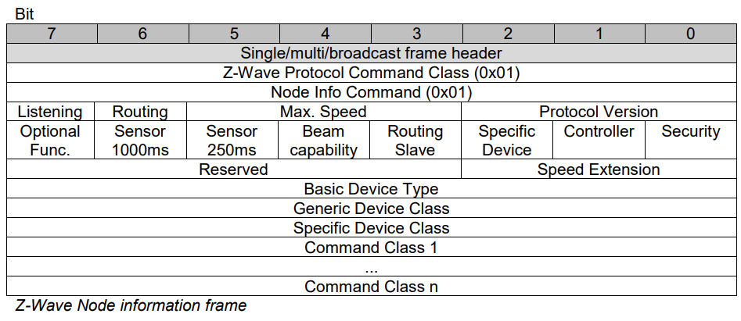
The Node Information Frame [NIF]
The business card of the Z-wave node
Announces protocol and Application level capabilities

Slide 12
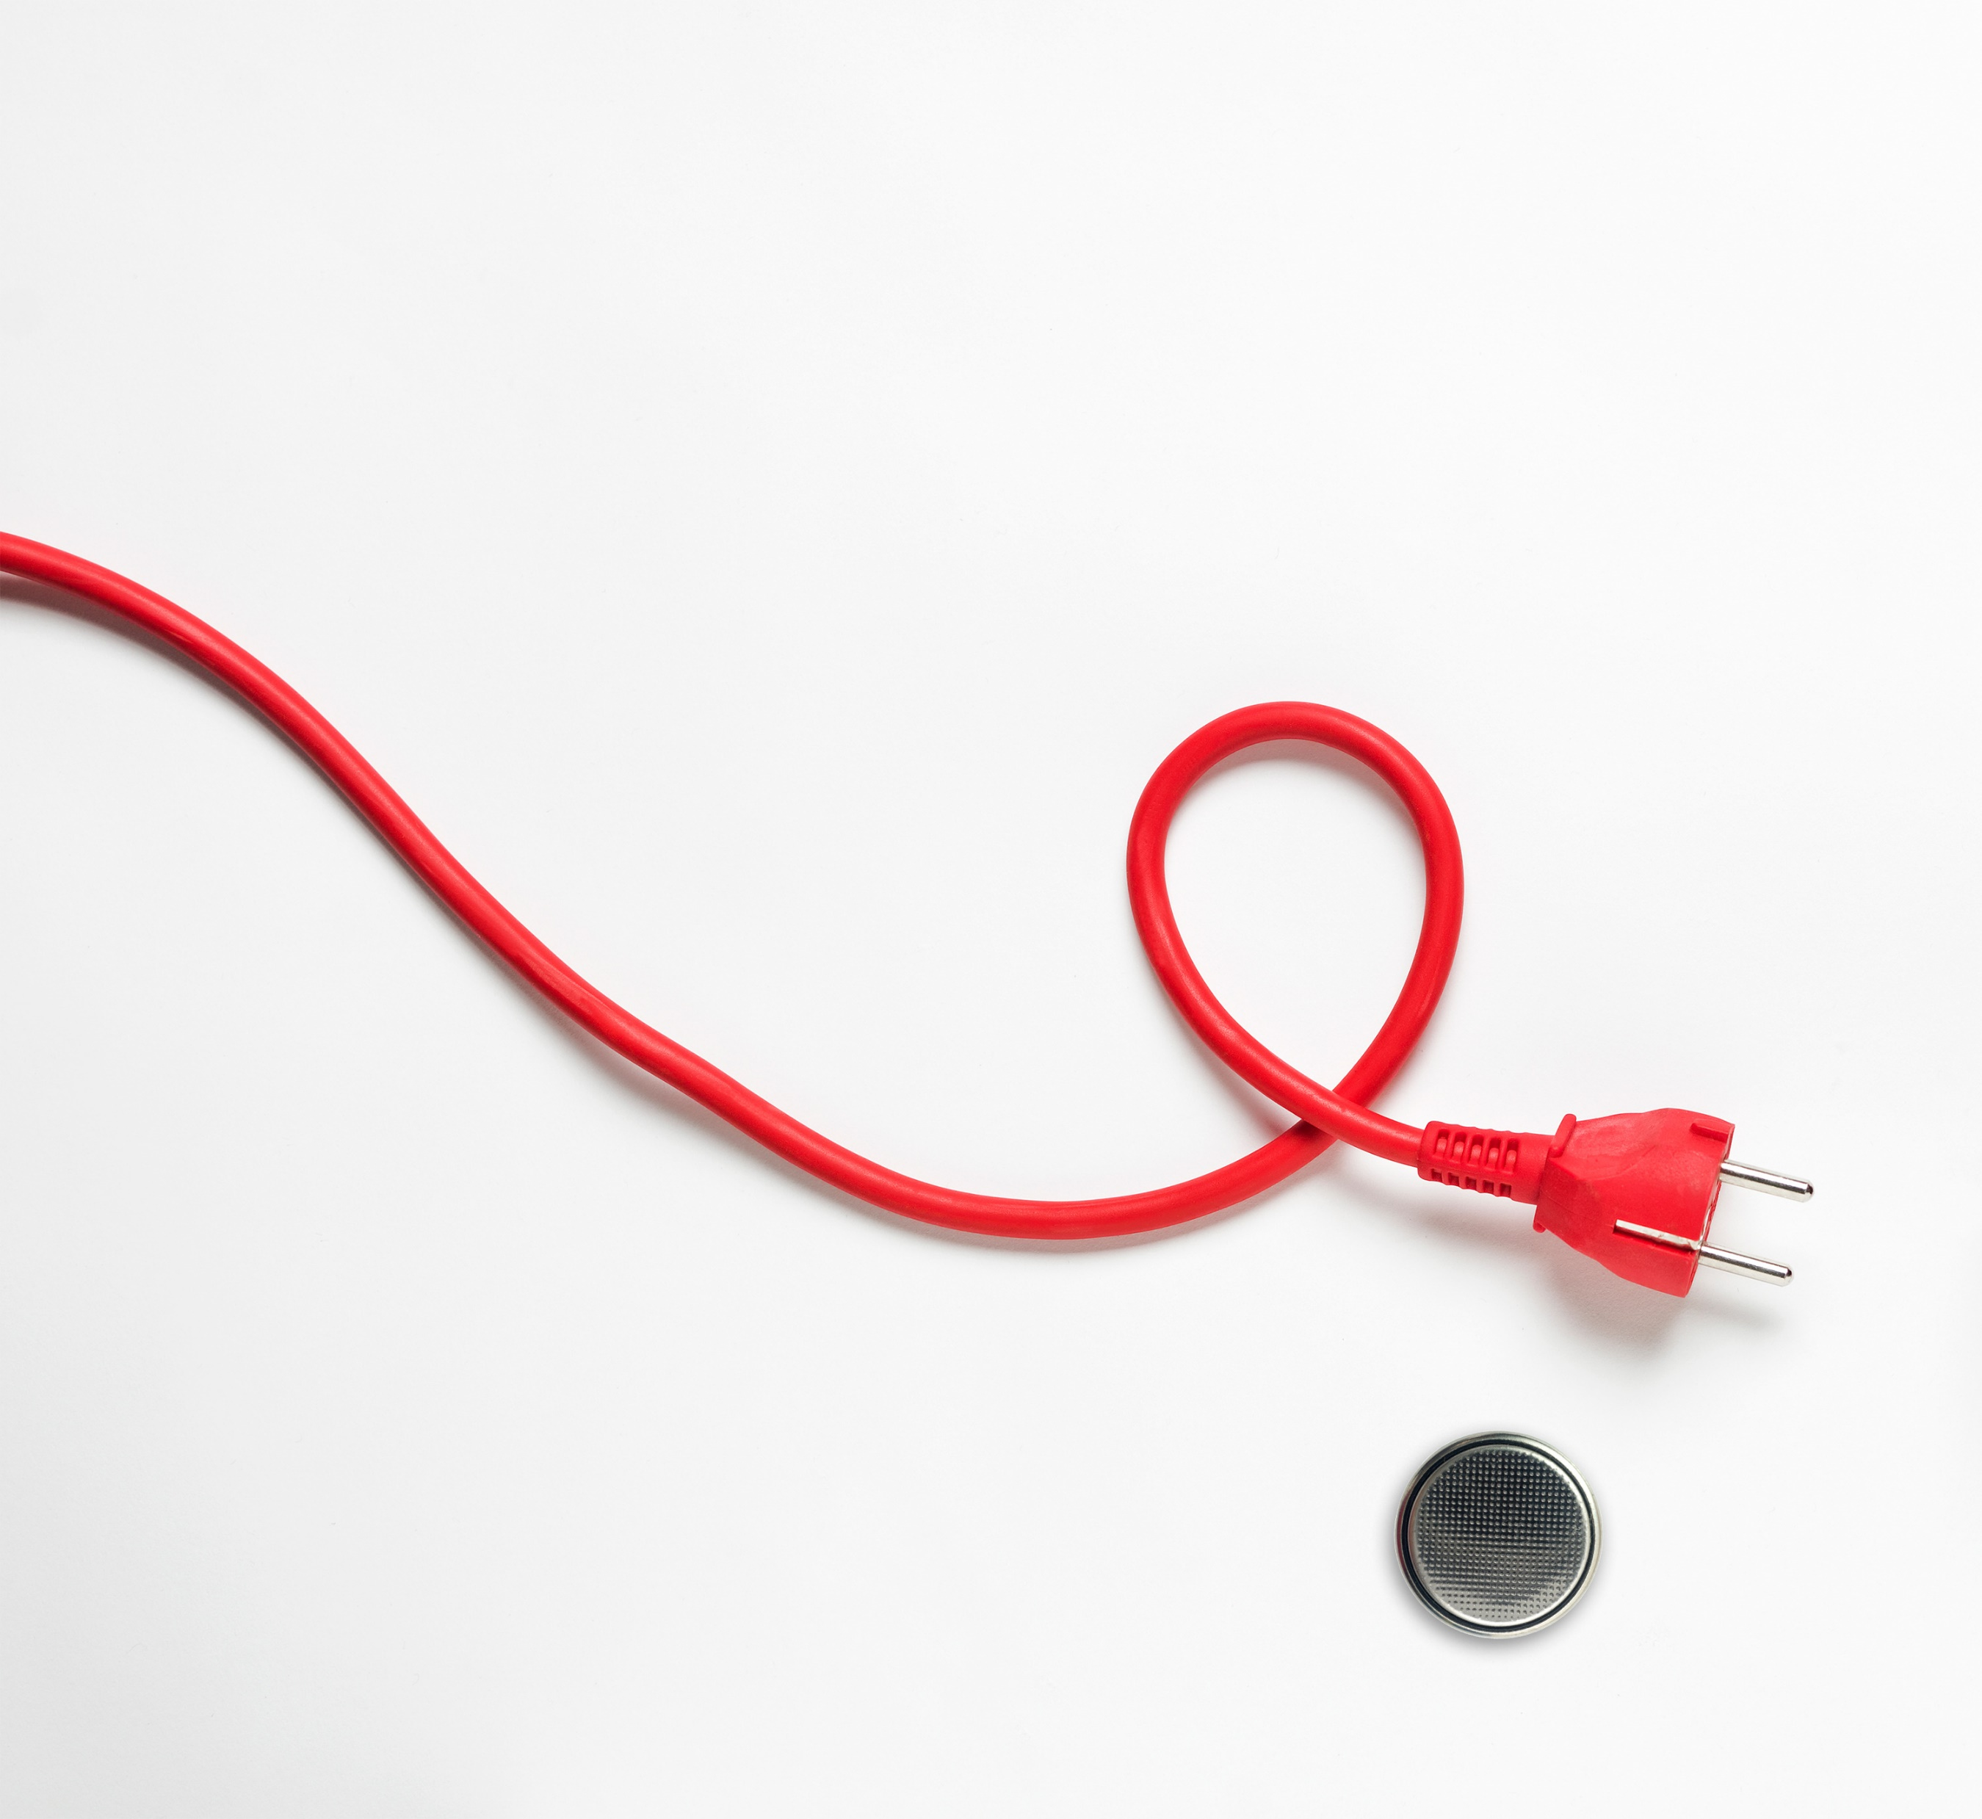
Node types
Mains powered
Static controller
Always on Slave [AOS]
Battery powered
Reporting Sleeping Slave [RSS]
Listening Sleeping Slave [LSS]
Legacy types (500 series and earlier)
Portable Controller [PC]
Reporting Portable Controller [RPC]

Slide 13


Always On Slave [AOS] / Controllers
Always reachable
Can receive and send commands at all times
The back-bone of the Z-wave mesh
Is a repeater in the network
Notes:
AOS nodes improves the routing properties of Z-wave by each node serving as repeater for the other nodes in the network.

Slide 14
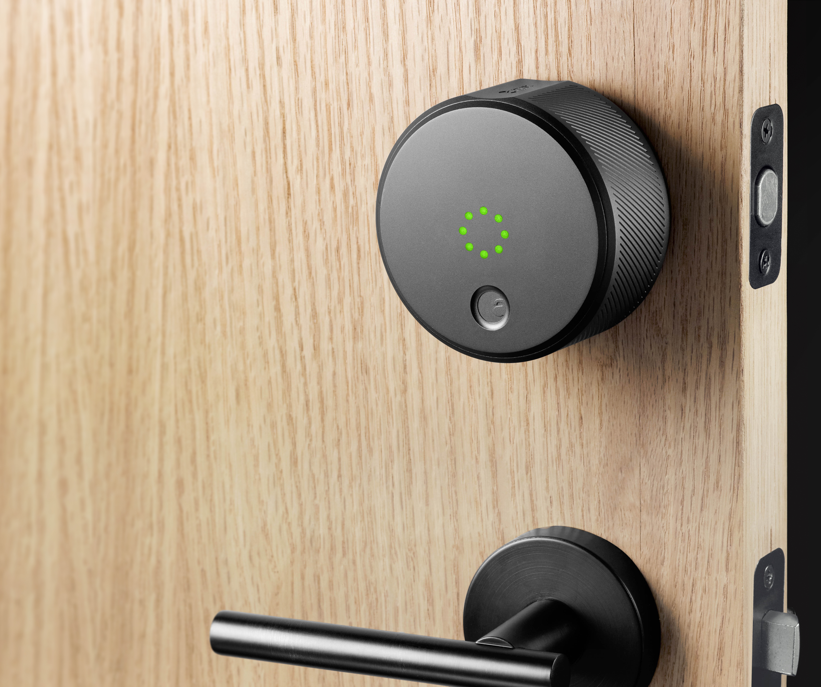
Listening Sleeping Slave [LSS]
Listens at a fixed interval
250ms or 1000 ms
Battery Powered
Can be reached by all nodes with latency <= 1s
Will wake up on timer or on events
Cannot be used as repeater

Slide 15
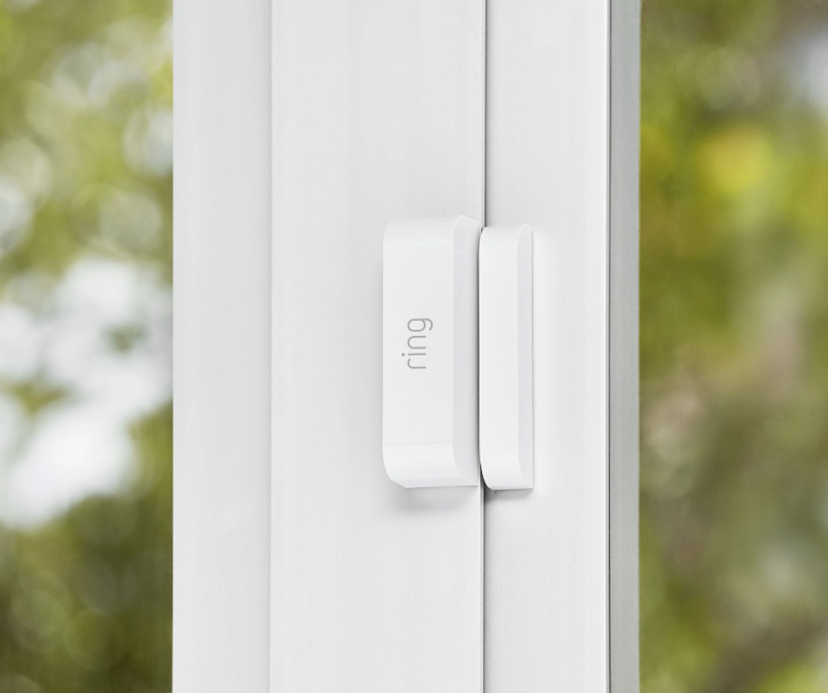
Reporting Sleeping Slave [RSS]
Battery Powered
Can not be reached by all nodes
Will wake up on timer or on events

Slide 16
Assigning return routes
Slaves does not by default know how other slaves can be reached
Assign Return route
Speed
Based on speed supported by routing hops and destination node
Routing hops required to reach the destination
Power state; is the destination a LSS
Multiple return routes can be assigned – up to 4
Notes:
If not routes are assigned, the protocol will try single hop 40kbps
Assigning routes allows for:
Improved speed
Reaching FLIRS nodes
Using routing hops to reach the destination.
Everything based on the NIF of source, destination and intermediate routing hops.
Higher level functionality such as security can be routed through nodes not supporting these command classes.

Slide 17
Associations
- What to send where

Slide 18





What are associations?
The Association Command Class is used to manage associations to NodeID destinations.
Allow a controller to automate interactions between nodes
Notes:
A NodeID destination may be a simple device or the Root Device of a Multi Channel device.

Slide 19
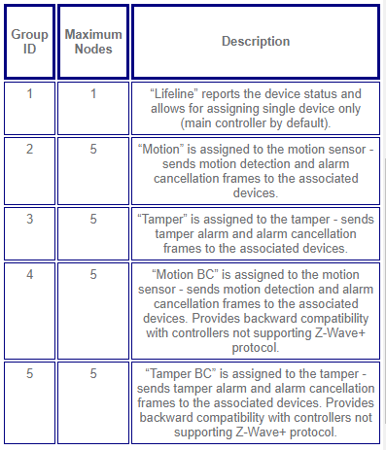

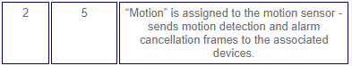

What Really are associations?
Table of list
Each list has members that are subscribed to it
Each list has a specific function
Notes:
That was a description but associations really are a table of lists
Each separate list has a different function defined by the manufacturer
Each list has a group of nodes that it will contact based on different events

Slide 20





How do associations work?
Set ID1 into lifeline group
4
1
Group No. | Group Name | Nodes in Group
1 | llifeline
Group No. | Group Name | Nodes in Group
1 | lifeline | 1
Set ID1 into lifeline group
Group No. | Group Name | Nodes in Group
1 | llifeline
Turn Siren On
Group No. | Group Name | Nodes in Group
1 | lifeline | 1
Motion Triggered
Set ID4 and 3 into group 2
Set ID1 into lifeline group
3
2
Group No. | Group Name | Nodes in Group
1 | llifeline
2 | on/off
Group No. | Group Name | Nodes in Group
1 | llifeline | 1
2 | on/off
Group No. | Group Name | Nodes in Group
1 | lifeline | 1
2 | on/off | 3,4
Turn Alert Light On
Notes:
The first group on any ZW+ device is the “Lifeline” group
The rest of the association groups are

Slide 21
Wakeup Command Class

Slide 22
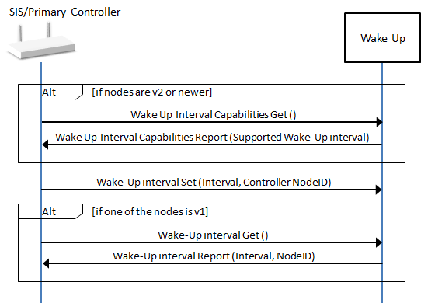
Wakeup Command Class configuration
Controller must
Query nodes for they wakeup intervals
Minimum, maximum and default wakeup interval
Set the wakeup interval and destination
Slave must
… implement a Minimum Wake Up Interval in the range 0 ..4200 (i.e. between 0 second and 70 minutes).
Notes:
The routing protocol allows for stable frame delivery

Slide 23
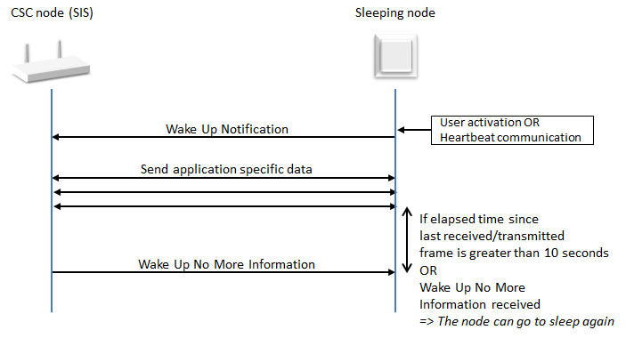
Wakeup runtime communication
Slave sends wakeup notification at fixed interval
Upon wake up notification controllers
Sends queued traffic
Puts node back to sleep

Slide 24
Thank you!
silabs.com
End of Lesson 2: Z-Wave Fundamentals

